Slide 1
Final Report
SE499: Software Design & Development Project

Slide 2
Comprehensive Documentation of the Entire Project
Project charter
System architecture
Design
Sprint retrospectives
Testing reports
Lessons learned and suggestions for future improvements

Slide 3
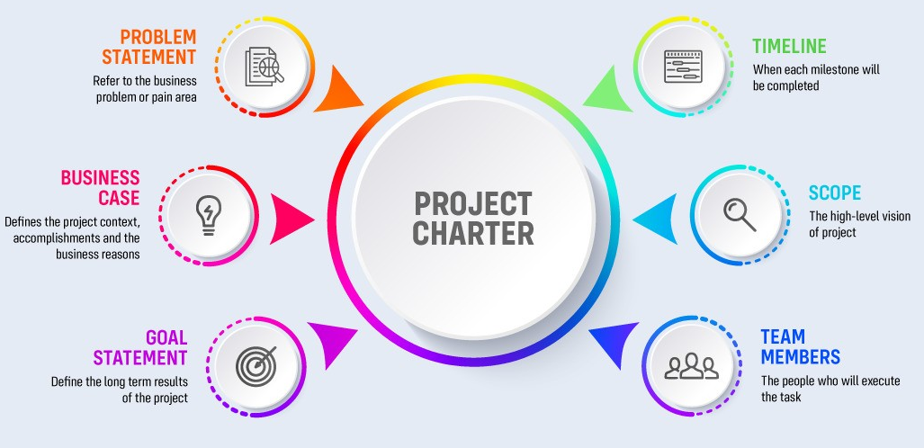
Project Charter
Project title and description
Objectives
Stakeholders
Risks
Constraints
KPIs

Slide 4

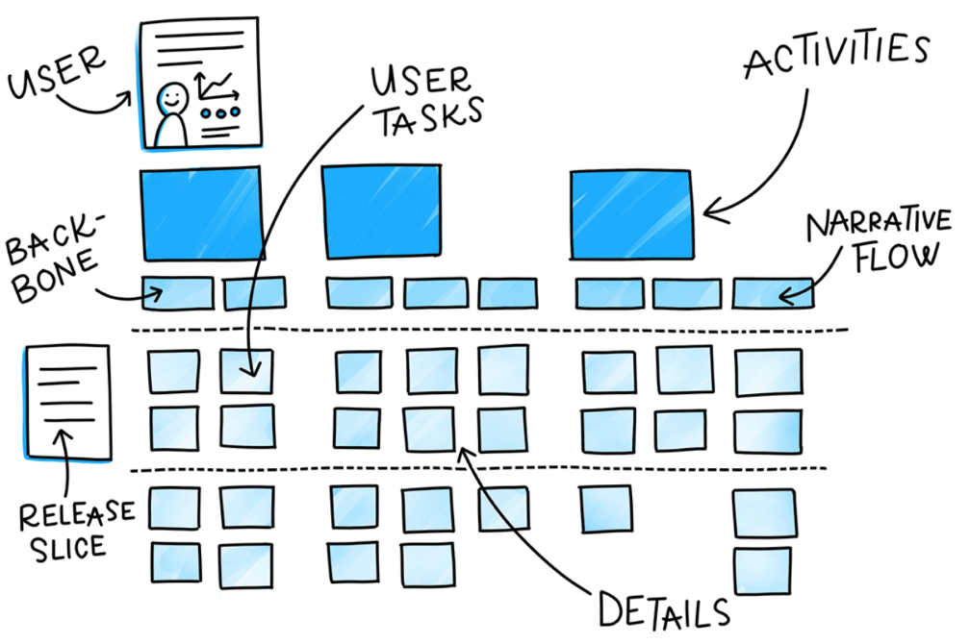
User Stories
Title
Description
Acceptance Criteria
Priority

Slide 5
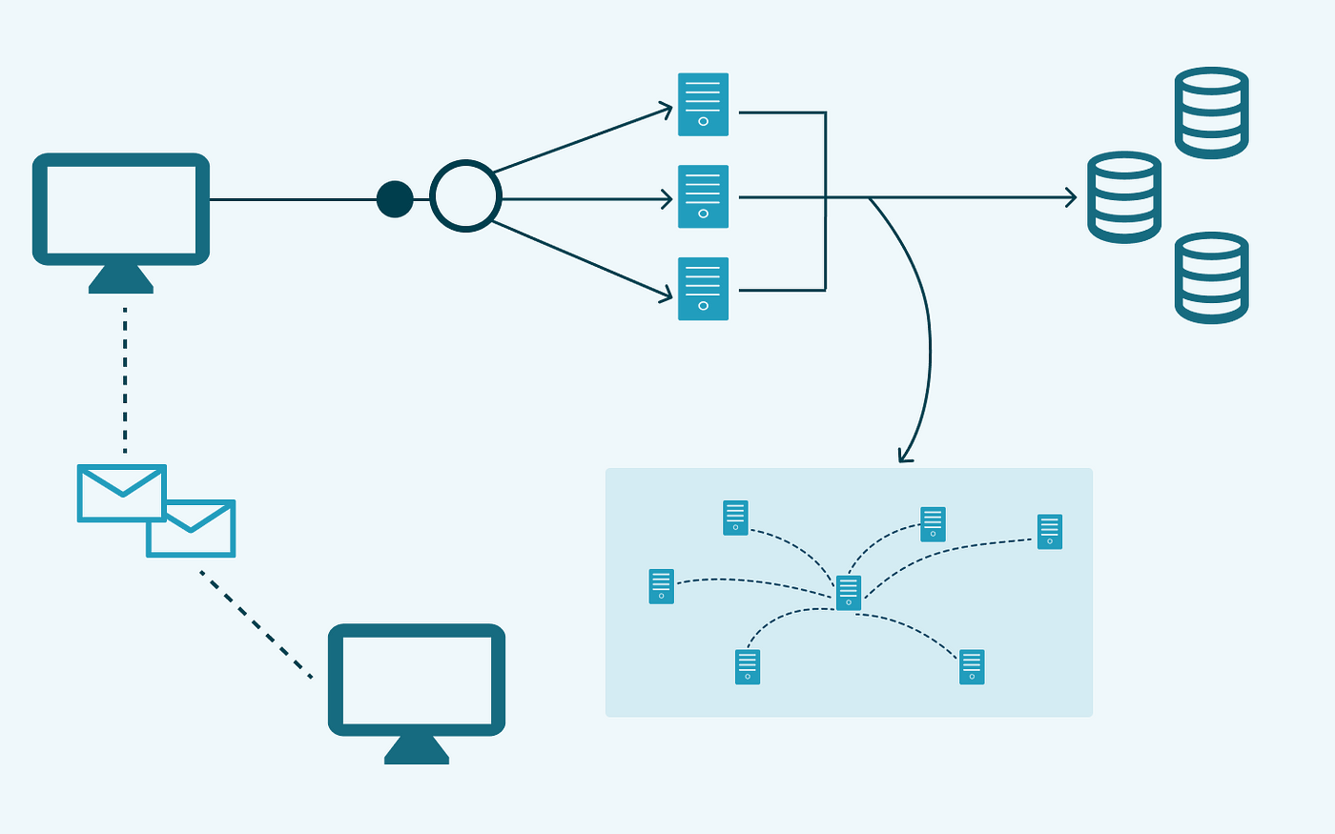
System Architecture
Major components
Interactions and relationships
External interfaces and interactions

Slide 6
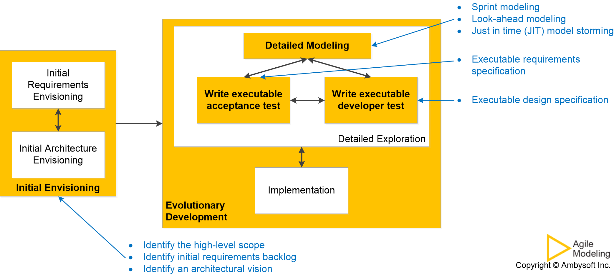
Design
Detailed level design diagrams
Design approach and reasoning
Description of design patterns used

Slide 7
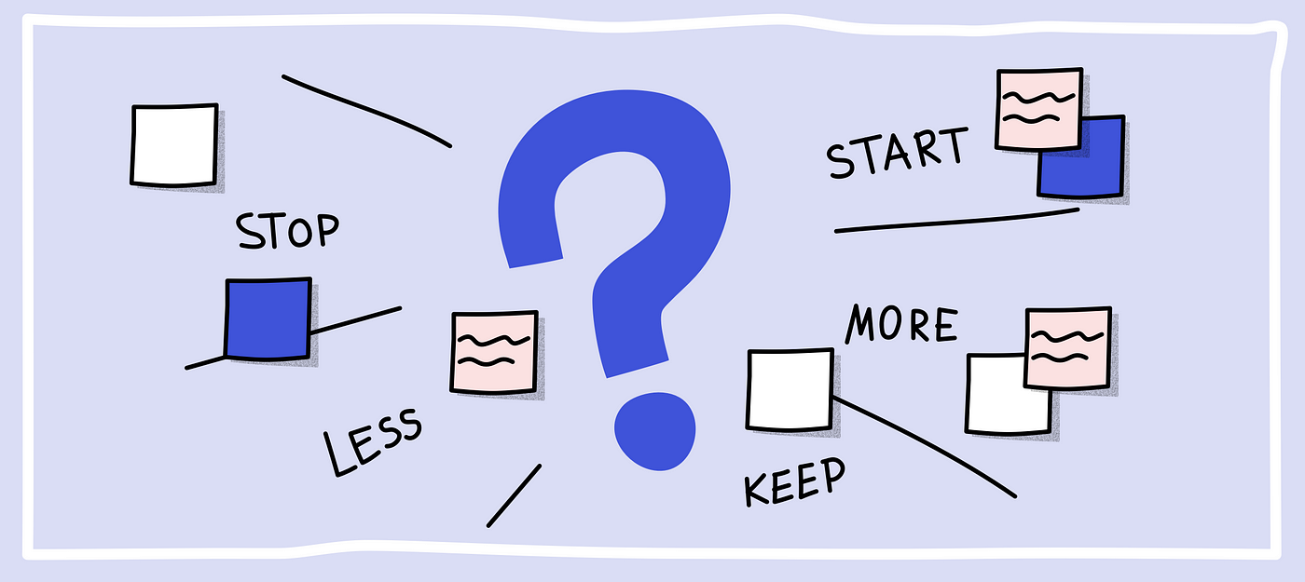
Sprint Retrospectives
Key takeaways
Action items
Improvements implemented

Slide 8
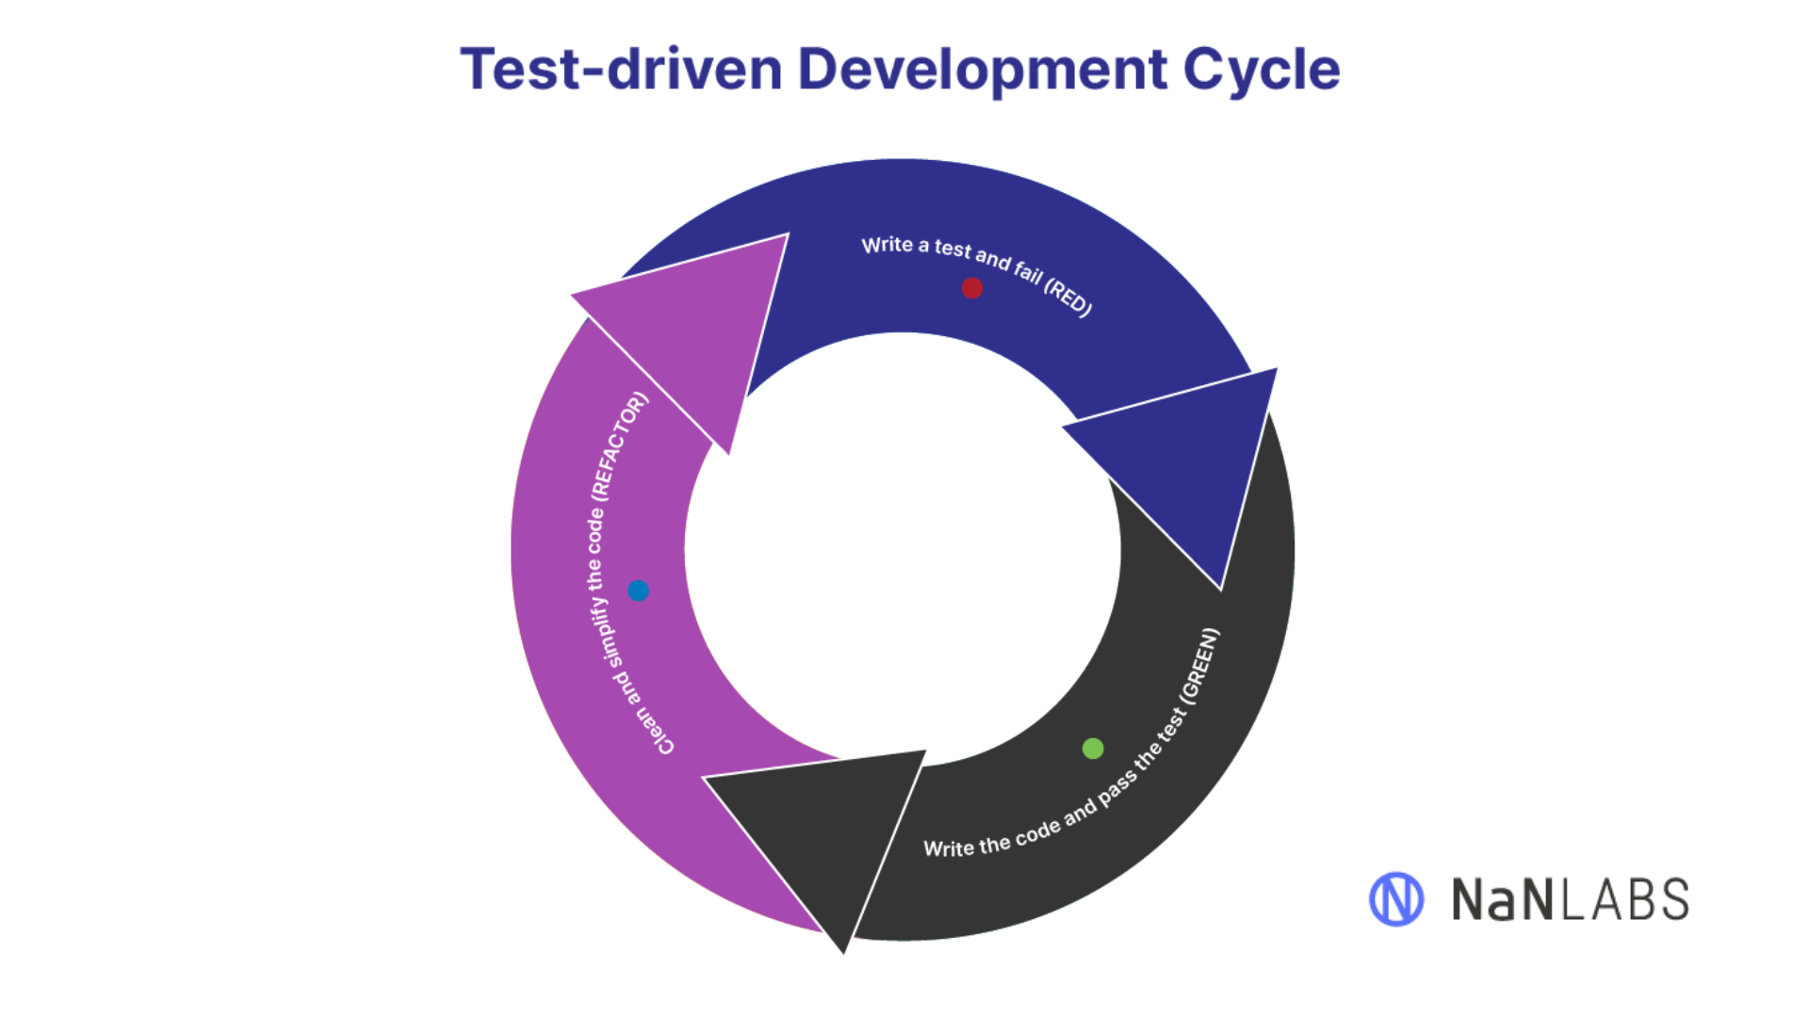
Testing Reports
Test plan
Test cases
Test results
Defect tracking

Slide 9
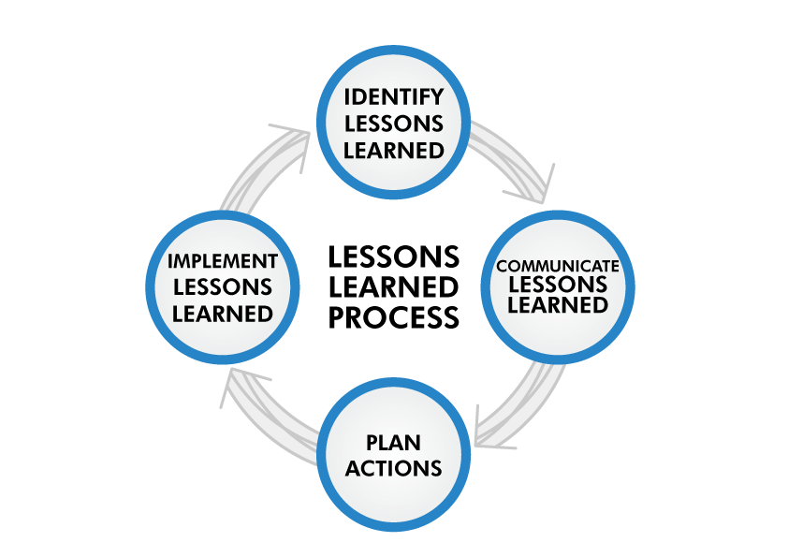
Lessons Learned and Suggestions for Future Improvements
Lessons learned
Suggestions for future improvements
Recommendations for future projects

Slide 10
Best Practices for Writing a Final Report
Clarify the scope of your project
Highlight what makes your project unique
Provide rational for user stories prioritization
Provide rational for design and technology decisions
Use diagrams, diagrams, diagrams
Use a clear, simple, and concise writing style

Slide 11
Best Practices for Writing a Final Report
Ensure consistency in formatting and style throughout the report
Use appendices to include supplementary information
Review and edit your report
Use headings and subheadings to organize content
Use bullet points and numbered lists

Slide 12
Final Project Report: A Valuable Resource for Teams
The final project report serves as a comprehensive documentation of the entire project, providing a valuable resource for teams to reflect on their work and facilitate knowledge transfer.

